Slide 1

Water Quality-Drinking water potability
Data Set
Presented by:
Snigdha Kola

Slide 2
INTRODUCTION:
The water potability file contains a dataset for analyzing water quality to predict potability.
It includes key chemical and physical parameters measured across multiple samples, suitable for exploratory data analysis (EDA) in data science tasks like classification modeling.​
Key Features
ph: Measures acidity/alkalinity levels, typically ranging from low to high values like 1.43 to 11.9.
Hardness: Indicates mineral content, affecting water usability, with values around 47 to 331.
Solids: Total dissolved solids impacting taste and safety, often in thousands (e.g., 300-8000 ppm).
Other columns: Chloramines (disinfectant), Sulfate, Conductivity, Organic_carbon, Trihalomethanes (THMs), Turbidity (cloudiness).​
Target Variable:
Potability: Binary label (0: non-potable, 1: potable), used for supervised learning to classify safe drinking water.​

Slide 3
Dataset Overview
The dataset contains 3280 rows and 10 columns, capturing information about Water Quality-Drinking water potability.
This data set is focusing on water quality parameters for potability prediction. It features numeric features with some missing values and a binary target.
​
Columns : ph, Hardness, Solids, Chloramines, Sulphate, Conductivity, Organic carbon, Trihalomethanes, Turbidity (predictors).
Potability (target: 0 non-potable, 1 potable).​

Slide 4
KEY COLUMNS OVERVIEW
ph: Acidity level (mean 7.08, std 1.60, range 0-14); neutral around 7, extremes may indicate contamination.​
Hardness: Calcium/magnesium content (mean 196, std 33, range 47-323); higher values suggest scaling issues.
​
Solids: Dissolved solids (mean 22014 ppm, std 8766, range 321-61227); affects taste and purity.
​
Chloramines: Disinfectant residual (mean 7.12, std 1.58, range 0.35-13.13); prevents regrowth but high levels toxic
.​
Sulfate: Mineral ion (mean 334, std 41, range 129-481); excess causes laxative effects.
​
Conductivity: Ion concentration proxy (mean 426, std 81, range 181-753); correlates with total dissolved ions.​
Organic carbon: Dissolved organics (mean 14.28, std 3.31, range 2.2-28.3); indicates pollution source.​
Trihalomethanes (THMs): By product of disinfection (mean 66, std 16, range 0.74-124); carcinogenic at high levels.
​
Turbidity: Cloudiness (mean 3.97, std 0.78, range 1.45-6.74); signals particulates affecting clarity.

Slide 5
Problem Statement
Access to safe drinking water remains a global challenge, with pollution causing diseases especially in resource-limited areas. This dataset enables building machine learning models to predict water potability from 9 key physicochemical parameters, aiding rapid quality assessment without lab testing.​​
Core Objective: Classify water samples as potable (1) or non-potable (0) using supervised binary classification.​
Addresses imbalanced data (61% non-potable, 39% potable) via techniques like SMOTE oversampling.​​
Challenges:
1.Missing values in critical features: ph (15%), Sulfate (24%), Trihalomethanes (5%).​
2.Handle outliers and normalize features (e.g., Z-score) for model robustness.​
3.Feature interactions: Parameters like THMs and turbidity correlate with contamination risks.

Slide 6
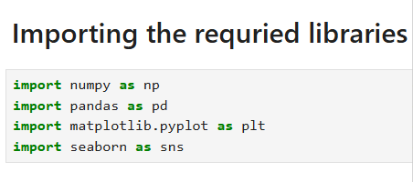
Library of import
1.Numpy(np):
Used for numerical operations such as arrays, mathematical computations, and handling missing values.
2. Pandas(pd):
Used for data manipulation and analysis.
3.Matplotlib (plt):
Used for basic plotting like line plots, scatter plots, bar charts, and histograms.
4. Seaborn (sns):
Makes it easy to create colorful and informative plots, e.g., count plots, box plots, heatmaps, and regression plots.

Slide 7
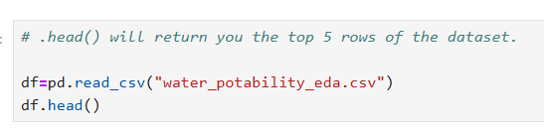
Loading csv file
Displays the first 5 rows of the DataFrame by defaultLeft joins are used to preserve Used to quickly inspect:
→column names
    →.data types
    →sample values

Slide 8
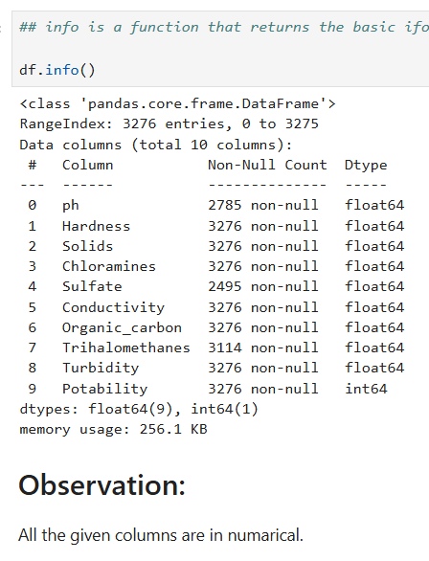
CHECK DATA STRUCTURE
All the columns have 3275 data points.
The columns belongs to object, float, and int data types.

Slide 9
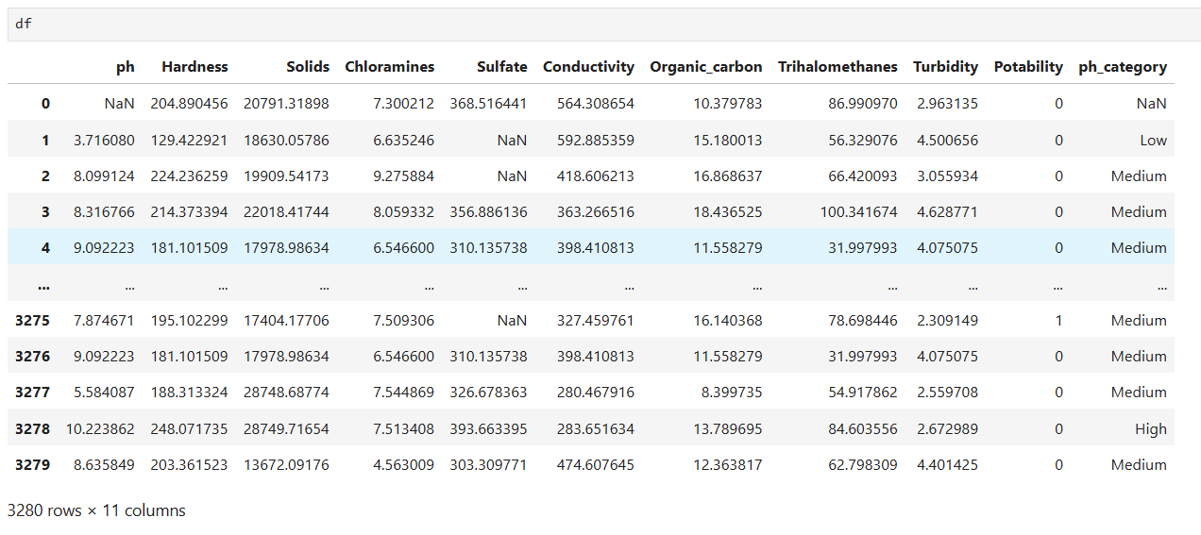
DATA SET

Slide 10
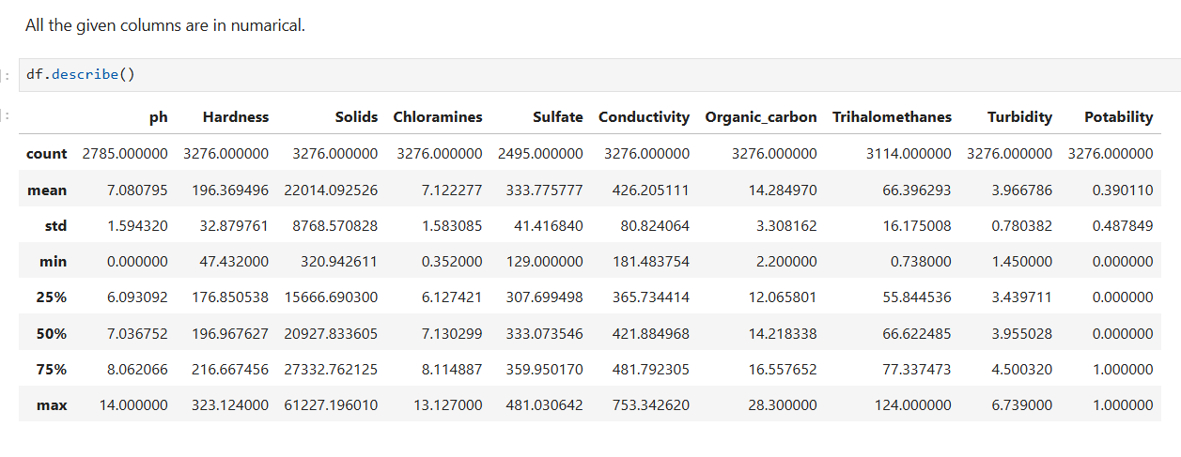
STATISTICS SUMMARY
Display descriptive statistics for numerical columns only
Shows count, mean, standard deviation, min, max
Includes 25%, 50% (median), and 75% percentiles

Slide 11
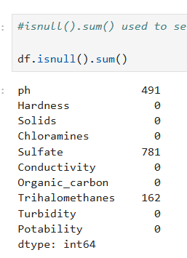
Identify MISSING VALUES
Observation:
in ph is 14% data is missing
in Sulfate is 23% data is missing
In Trihalomethanes 4% data is missing

Slide 12
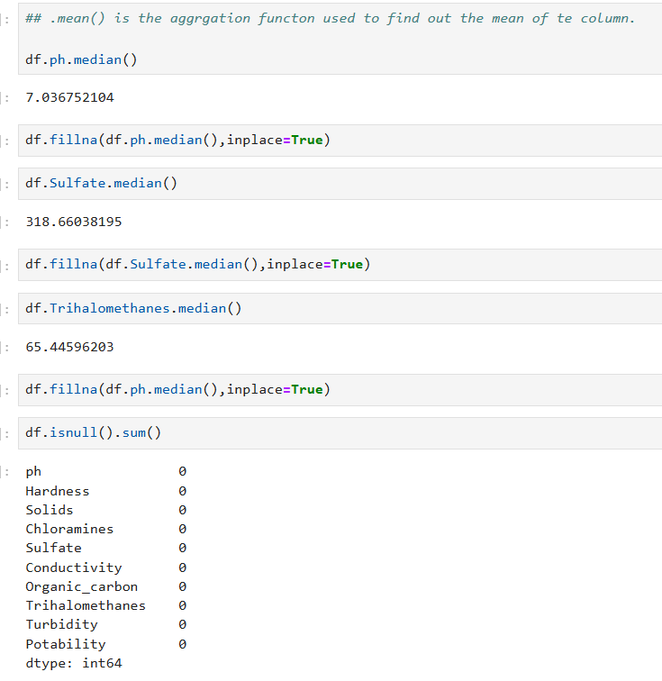
HANDLING MISSING VALUES

Slide 13
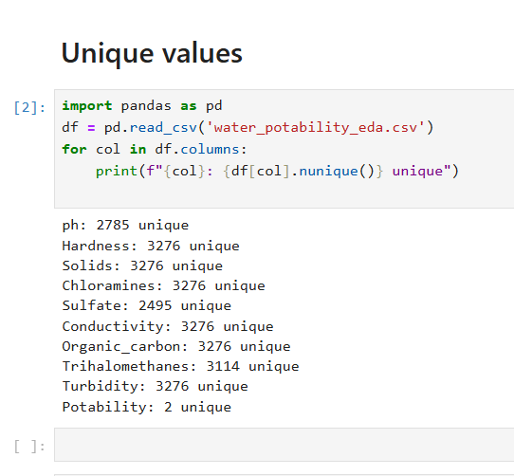
Unique values
Displays all unique values present in each column
Helps understand data categories and encoding
Identifies binary, categorical, and numerical features

Slide 14
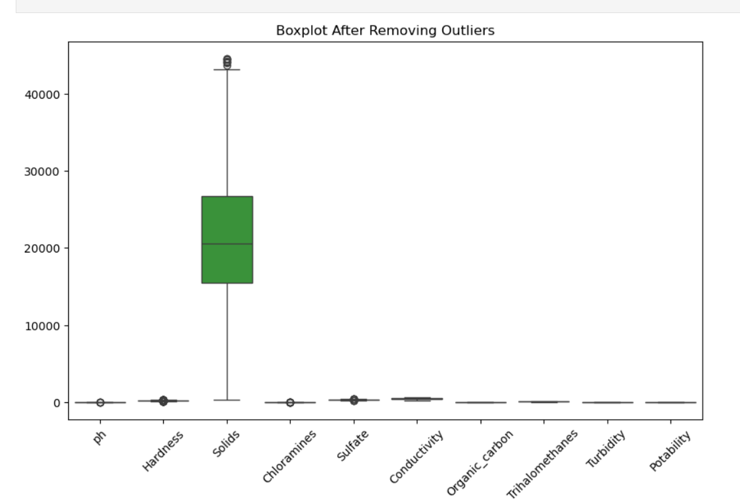
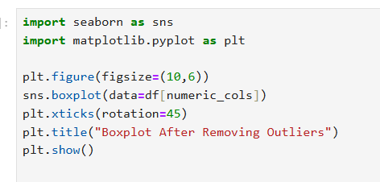
Visualization
Observation from Boxplots of Numerical Columns:
The code generates boxplots for all non-string (numerical) columns. Boxplots help identify:
Distribution of the data
Median and quartiles
Outliers

Slide 15
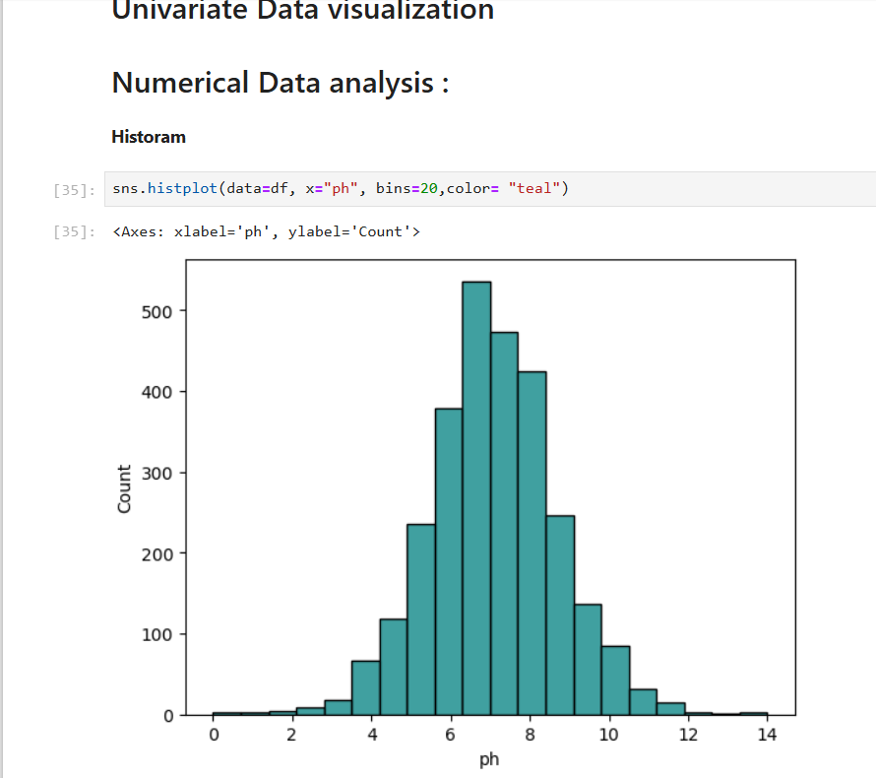
Data Analysis through Visualizations
Univariate Analysis:
Observation from Histograms:
Histograms display the frequency distribution of numerical columns. They help understand
Distribution shape (normal, skewed, uniform)
Data spread
Presence of outliers
Histogram:

Slide 16
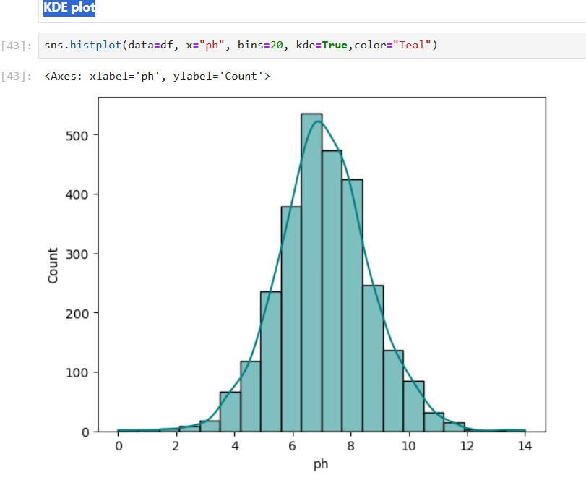
KDE plot:
Observation:
The histogram with KDE shows that pH values are approximately normally distributed, with most observations clustered around the central range.
The KDE curve confirms a single main peak, indicating no strong multimodality.
Only a small number of observations appear at the extremes, suggesting minimal skewness.

Slide 17
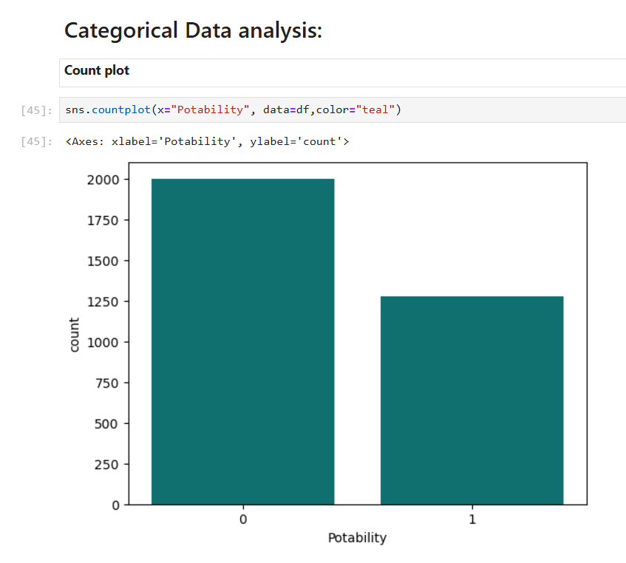
Count plot:

Slide 18
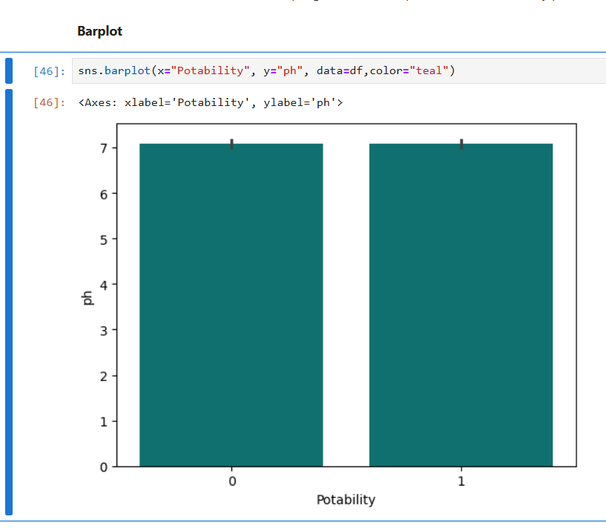
Bar plot
Observation:
1.here bar plot shows the frequency distribution of potable and non-potable water samples.
2.Non-potable samples are more frequent than potable ones.
3.This indicates a class imbalance in the target variable.

Slide 19
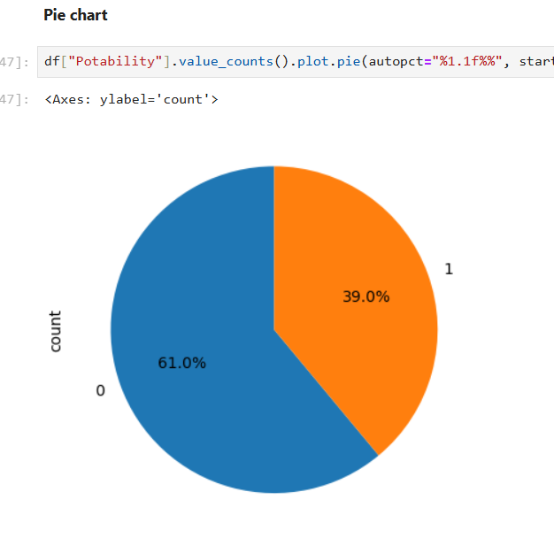
Pie chart:
Observation
he pie chart illustrates the percentage distribution of potable and non-potable water samples.
Non-potable water accounts for a larger portion of the dataset.
This indicates an imbalanced target variable that may need to be addressed during modeling

Slide 20
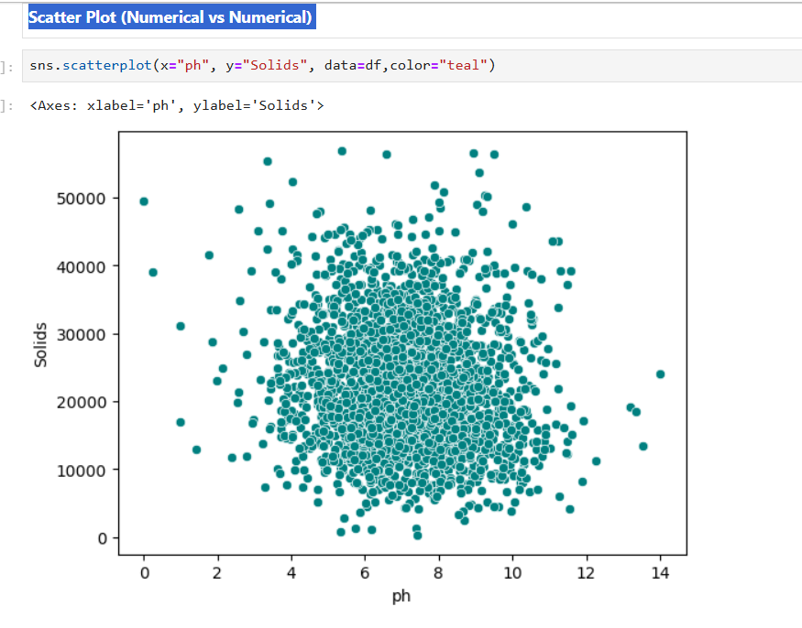
Bivariate Data visualization
Scatter Plot (Numerical vs Numerical)
Observation:
The scatter plot shows the relationship between pH and solids concentration.
The points are widely scattered, indicating a weak or no linear relationship.
No clear trend or strong correlation is observed between the two variables

Slide 21
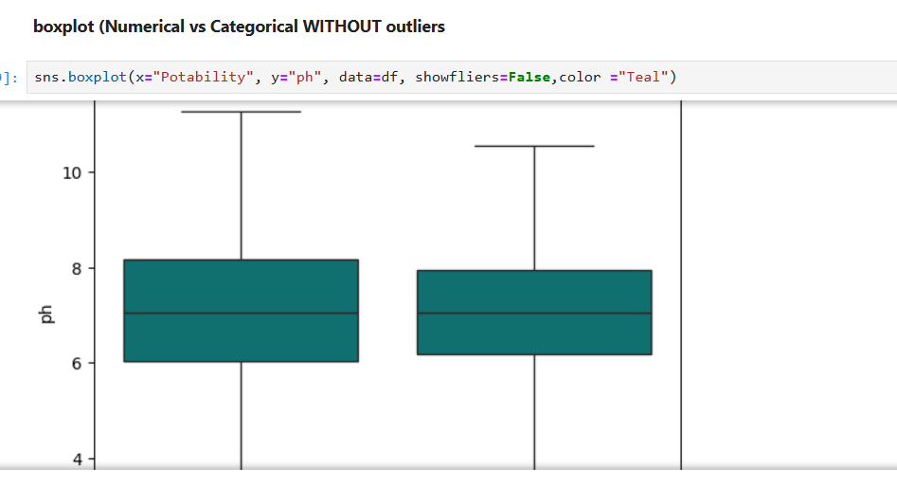
Boxplot (Numerical vs Categorical without outliers:
Observation:
The boxplot shows the central distribution of pH values for each potability category without the influence of outliers.
Both categories have similar median pH levels and interquartile ranges.
This indicates that pH distribution is largely consistent across potable and non-potable water samples.

Slide 22
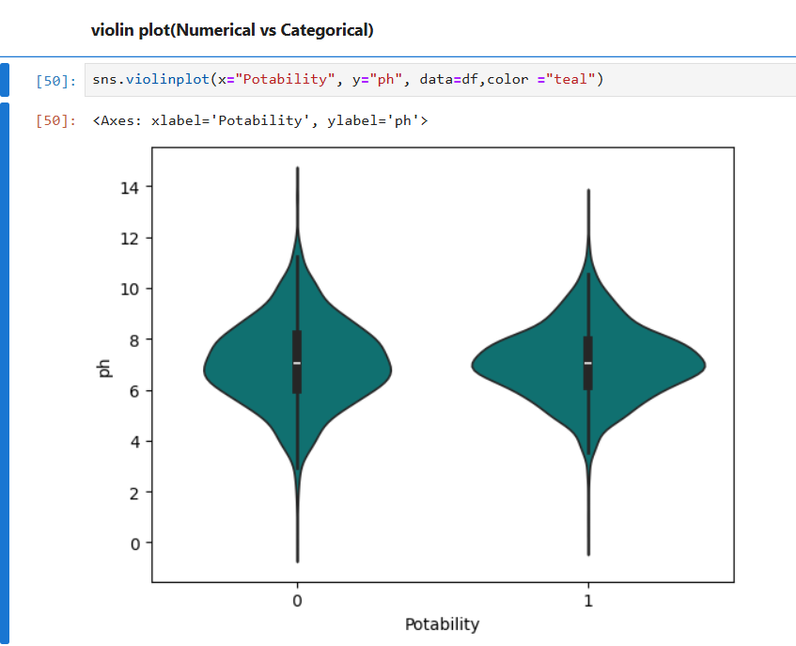
violin plot(Numerical vs Categorical):
Observation:
Shape and Density: Both violins exhibit symmetric, bell-like shapes with central peaks around pH 7, indicating near-normal distributions for potable and non-potable water.​
Median and Spread: Medians align closely (~7.0-7.1), with similar interquartile widths (IQR ~1.5-2.0), showing overlapping variability across categories.​
Implication: Minimal divergence in violin profiles confirms pH lacks discriminatory power for potability prediction.

Slide 23
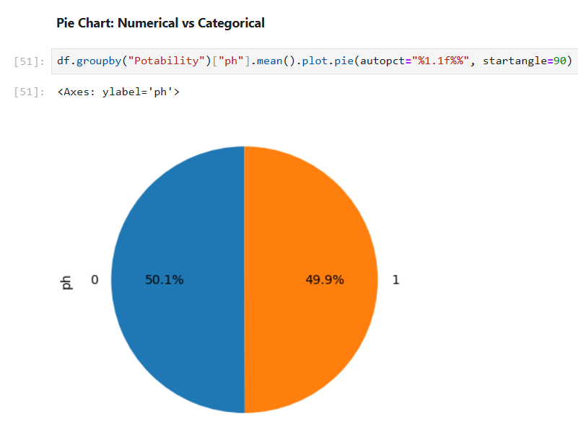
Pie Chart: Numerical vs Categorical*
Observation:
The pie chart represents the proportion of average pH contributed by each potability category.
Both potable and non-potable water contribute nearly equal shares to the overall average pH.
This indicates that pH values are fairly similar across potability classes.

Slide 24
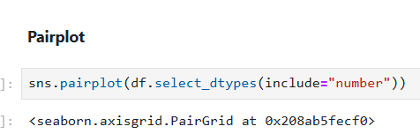
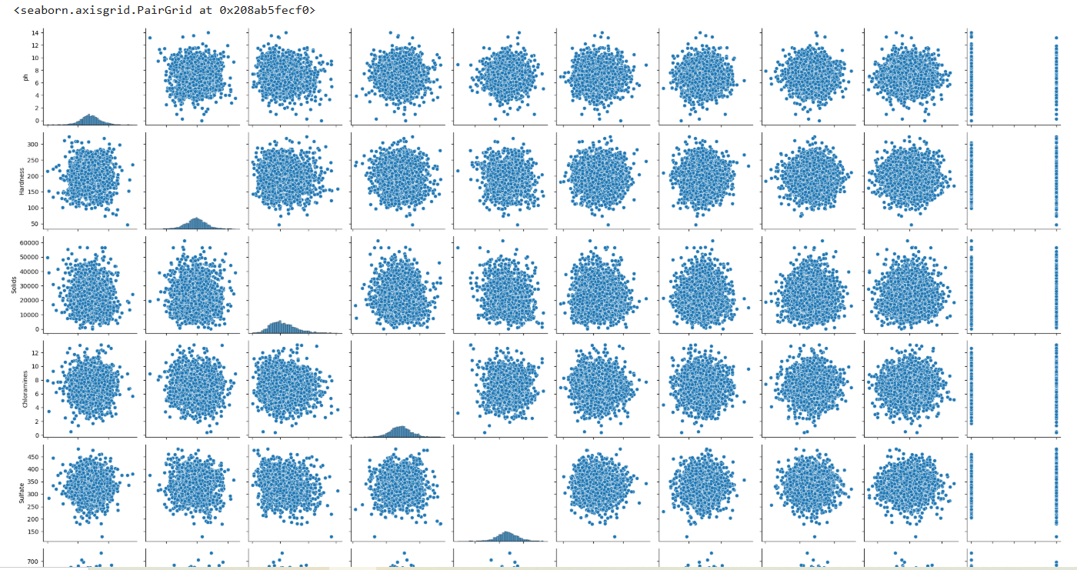
Multivariate Data visualization

Slide 25
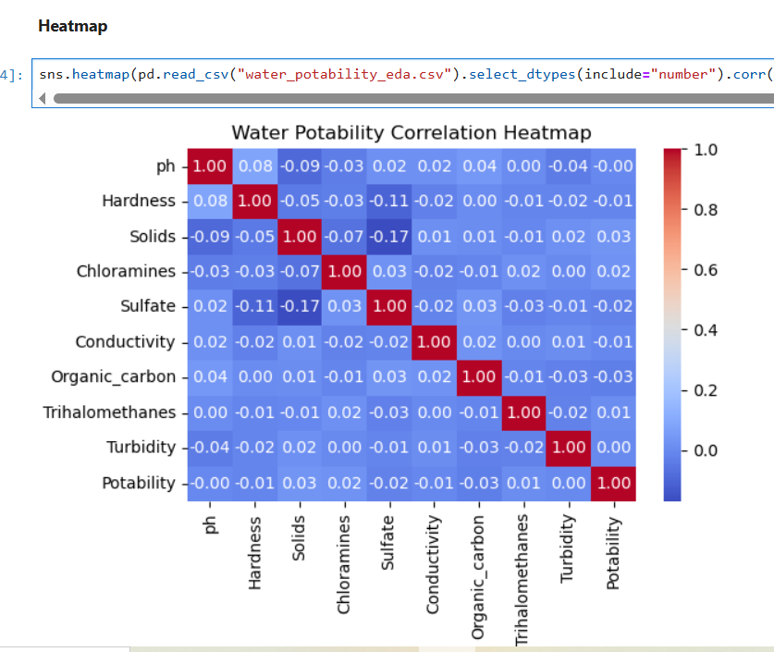
Observation from the correlation Heatmap
Heatmap shows correlation between numerical variables
Color intensity represents strength and direction of correlation
Values range from -1 to +1
MonthlyCharges has a moderate positive correlationwitTotalCharges

Slide 26
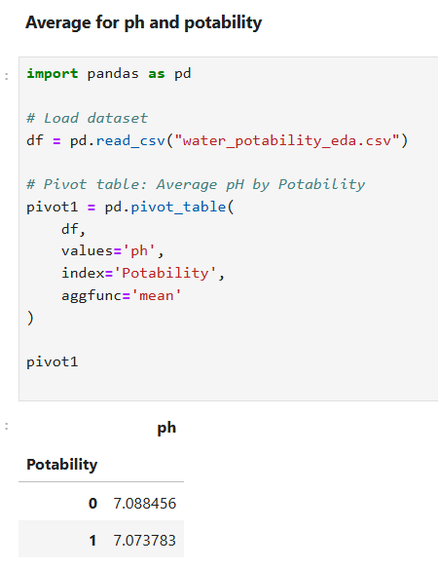
Pivot Table:
Observation
The average pH value for both potable and non-potable water is close to neutral (~7). This shows that pH alone is not a strong factor in determining water potability.

Slide 27
Conclusion – Water Quality-Drinking water potability Data Set
Dataset provides a concise EDA overview of the Water Potability dataset (3,280 rows, 10 features). It reveals class imbalance and overlapping feature distributions, stressing multi-variable analysis.​
Core Structure 9 predictors (pH, Hardness, Solids, etc.) + binary Potability target.
Non-potable samples dominate.​
Key Plots & Stats Histograms/KDE: Normal distributions for pH/Hardness.
Counts/Bars: Similar averages across classes (e.g., Turbidity ~3.97, Solids ~22k).​
Takeaway No standalone predictor; clean data and model combinations for potability prediction.

Slide 28
Conclusion
The Dataset concludes that Water Potability data lacks clear single-feature separation. Overlapping distributions and imbalance indicate no easy predictor; multi-feature modeling is essential.​
Final Insights Imbalance: 61% non-potable vs. 39% potable—requires resampling.​
Feature Overlaps: Means similar across classes (e.g., Turbidity 3.97, Hardness 196).​
Data Issues: Missing in pH (15%), Sulfate (24%).

Slide 29

THANK YOU

